Slide 1
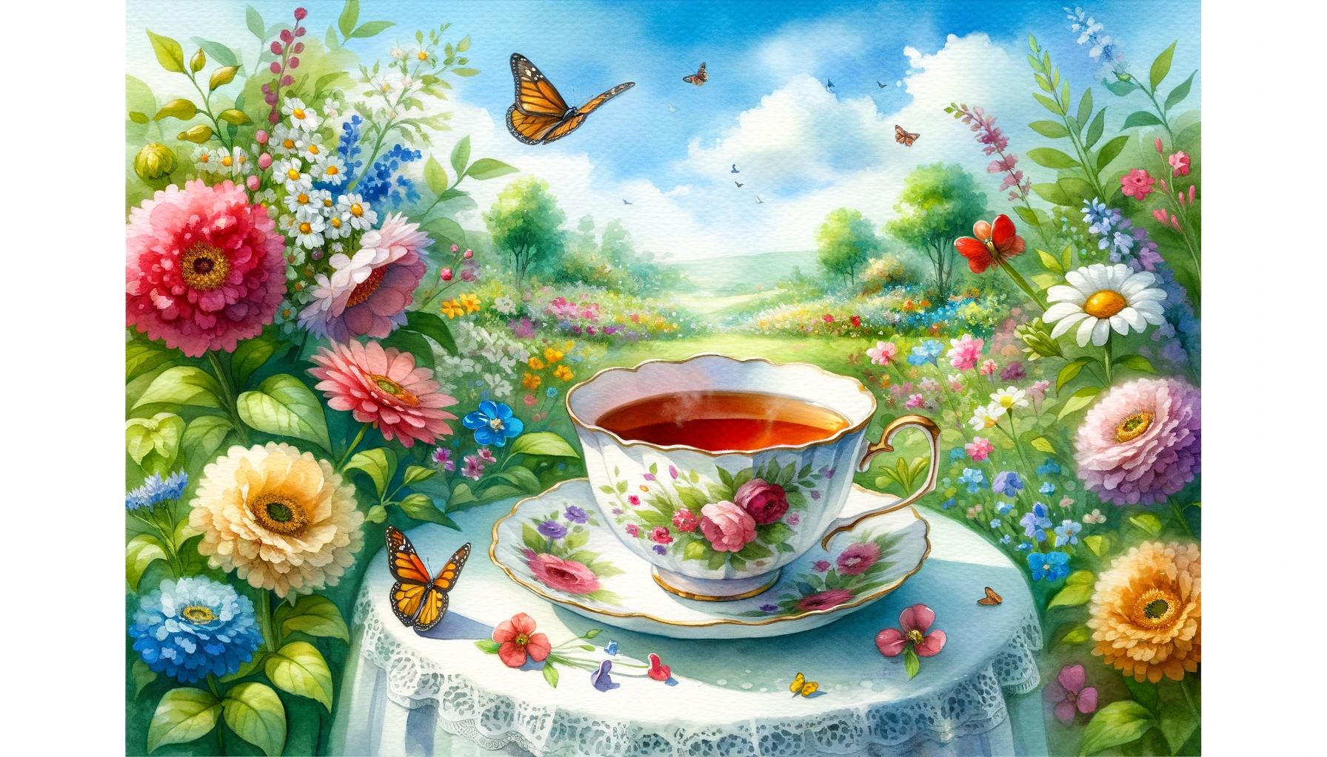
Watercolor painting of a tea cup placed in a lush garden setting. Colorful flowers bloom around, and butterflies flutter nearby. The weather is perfect, with a clear blue sky and a gentle breeze that rustles the leaves. The aroma of the tea mingles with the scent of fresh flowers, creating a rejuvenating atmosphere.

Slide 2
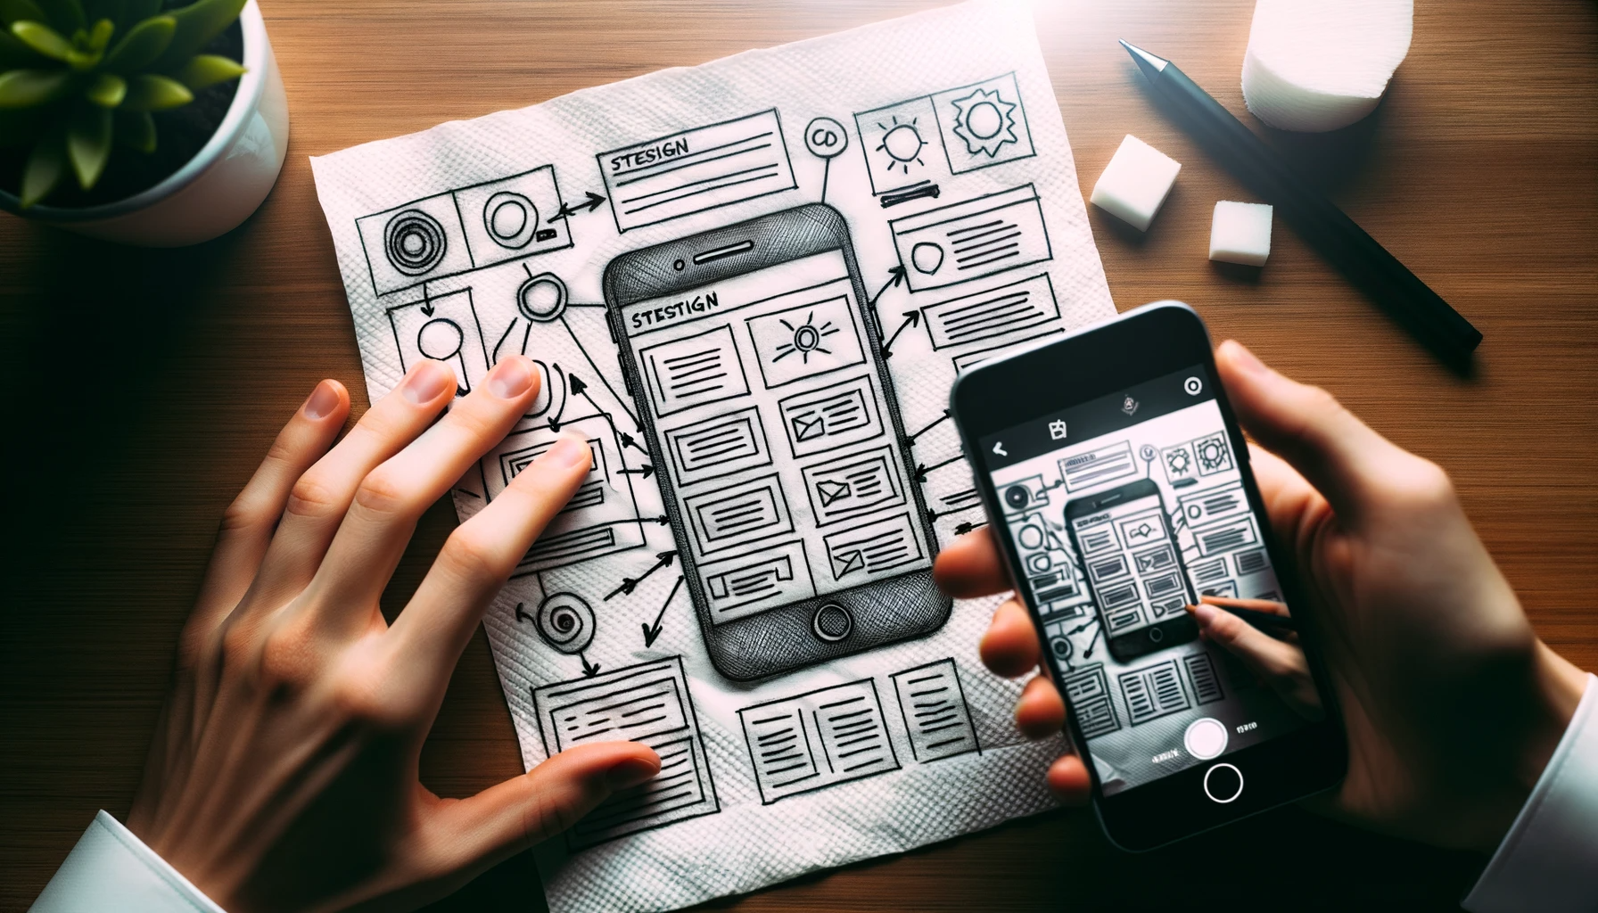
Photo of a hand-drawn website UI diagram on a napkin, complete with annotations and design elements. The perspective suggests it's been freshly photographed by a camera, with subtle lens flares and shadows. Adjacently, on a digital device screen, a web application is displayed, mirroring the design from the napkin, emphasizing the translation of the sketch to a functional site.

